Slide 1


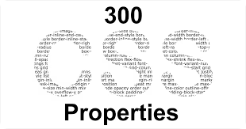
CSS Properties
This presentation explores CSS concepts and properties. Learn to enhance web design using CSS.
Presented by: Pratyush Maharjan.

Slide 2
Content
CSS Properties
CSS colors
Typography with CSS Font Properties
Debugging CSS with Browser DevTools
CSS Margin Properties
Understanding CSS Padding Properties
Styling with CSS Border Properties
Conclusion & Tips

Slide 3
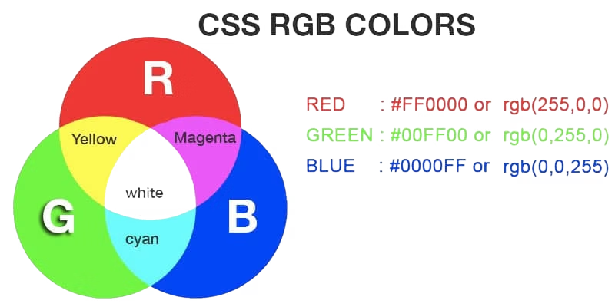
CSS Colors
Color Properties
Names: color: blue;
HEX: color: #0000FF;
RGB: color: rgb(0,0,255);
HSL: color: hsl(240, 100%, 50%);

Slide 4





Typography with CSS Font Properties
Font Family
Specify a list of fonts
Example: font-family: "Arvo", serif;
Font Size
Set the size of the text
Example : font-size: 3rem ;
Font Weight
Control the thickness of the font
Example : font-weight: 300 ;
Text Align
Sets content positioning.
Example : text-align: center ;

Slide 5

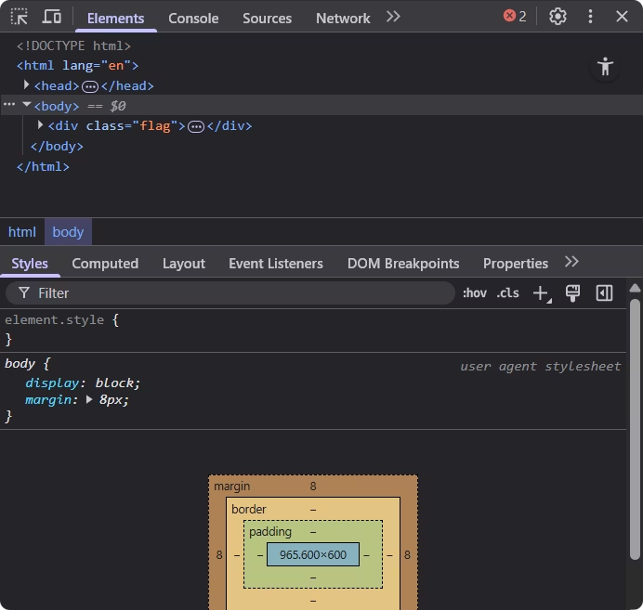


Debugging CSS with Browser DevTools
Inspect Elements
Right-click, choose "Inspect" or Ctrl + Shift + I
Edit Live CSS
Modify styles in real-time.

Slide 6
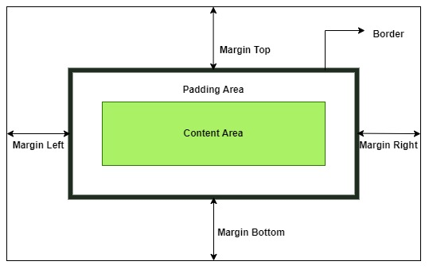
CSS Margin Properties
Margin
Outer spacing part outside the border
Example: margin: 30px ;
Margin Inline
Horizontal margin
Example: margin-inline: 20px 40px ;
Centering
Use margin to center elements.
Example: margin: 0px ;

Slide 7
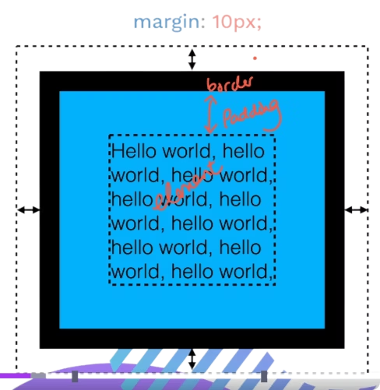



Understanding CSS Padding Properties
In between the width and height of the border is Padding.
Example: padding: 10px ;
Readability
1
Improves text spacing
Visual Layout
2
Enhances element spacing
Inner Space
3
Spacing within an element

Slide 8
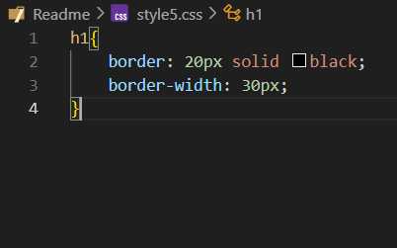
Styling with CSS Border Properties
1
Border
Sets border properties.
Example: border: 20px ;
2
Border Width
Defines border thickness.
Example: border-width: 30px ;
3
Border Style
Specifies border style.
Example: border-style: solid ;
4
Border Color
Sets border color.
Example: border-color: black ;

Slide 9

Conclusion
CSS color: Color in CSS are used to change the color of the text.
2) Typography with CSS font properties: Typography in CSS controls the appearance of the text using the font properties like font-family, font-size, font weight etc.
3) Debugging CSS with Browser Dev tool: Using the dev tool of the browser we can see the websites code and can edit the code in real time.
4) CSS Margin properties: Margin is used to create the space outside of
element’s border.
5) Understand CSS using Padding properties: Padding in CSS adds space inside an
element, between the content and the border making it look neat and readable.
6) Styling with CSS Border Properties: Border properties allows to style the edge of an element, defining its width, style, color.

Slide 10
Any questions?
?
…

